Slide 1
Outline
Introduction to SQL
DDL Commands
CREATE
SQL Data Types
SQL Constraints
ALTER
DROP
TRUNCATE
RENAME

Slide 2
SQL (Structured Query Language)
SQL is a language to specify queries in structured manner.
Structured means relational data
SQL is a language to specify queries in a relational database
SQL is a standard language for storing, manipulating and retrieving data stored in a relational databases.
SQL allows users to communicate with Relational Databases and retrieve data from their tables.
SQL is the standard language for RDBMS.
All Relational Database Management Systems (RDBMS) like MS SQL Server, IBM DB2, Oracle, MySQL, and Microsoft Access use SQL as standard database language.
The data in RDBMS is stored in database objects called tables.
A table is a collection of related data entries and it consists of columns and rows.

Slide 3
SQL (Structured Query Language)
SQL is a domain specific language
SQL is declarative language i.e a non-procedural language
SQL allows to declare what we want to do, but not how to do
In SQL, we can specify through queries that what data we want but does not specify how to get those data.
Whereas, C is procedural language as it uses functions, procedures, loops etc. to specify what to do and how to do it.

Slide 4
History of SQL
SQL was initially developed at IBM by Donald D. Chamberlin and Raymond F. Boyce after learning about the relational model from Edgar F. Codd^{[14]} in the early 1970s
This version, initially called SEQUEL (Structured English Query Language), was designed to manipulate and retrieve data stored in IBM's original quasi-relational database management system, System R
SQL became a standard of the American National Standards Institute (ANSI) in 1986, and of the International Organization for Standardization (ISO) in 1987.
New versions of the standard were published in 1989, 1992, 1996, 1999, 2003, 2006, 2008, 2011 and, most recently, 2016

Slide 5
What Can SQL do?
SQL can execute queries against a database
SQL can retrieve data from a database
SQL can insert records in a database
SQL can update records in a database
SQL can delete records from a database
SQL can create new databases
SQL can create new tables in a database
SQL can create stored procedures in a database
SQL can create views in a database
SQL can set permissions on tables, procedures, and views

Slide 6
SQL : Data Definition Language (DDL)
It is used to define database structure or pattern.
It is used to create schema, tables, indexes, constraints, etc. in the database.
Using the DDL statements, you can create the skeleton of the database.
Data definition language is used to store the information of metadata like the number of tables and schemas, their names, indexes, columns in each table, constraints, etc.
Here are some tasks that come under DDL:
Create: It is used to create objects in the database.
Alter: It is used to alter the structure of the database.
Drop: It is used to delete objects from the database.
Truncate: It is used to remove all records from a table.
Rename: It is used to rename an object.
Comment: It is used to comment on the data dictionary.

Slide 7
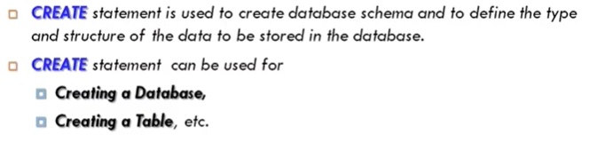
CREATE

Slide 8
SQL Create Database
In SQL, the 'Create Database' statement is a first step for storing the structured data in the database.
The database developers and the users use this statement in SQL for creating the new database in the database systems.
It creates the database with the name which has been specified in the Create Database statement.
Syntax of Create Database statement in SQL
CREATE DATABASE Database_Name;
Example :
This example creates the Student database.
To create the Student database, you have to type the following command in Structured Query Language:
CREATE DATABASE Student ;
SHOW Statement :
To see existing databases and tables
SHOW databases.
SHOW tables.

Slide 9
SQL CREATE TABLE
SQL CREATE TABLE statement is used to create table in a database.
If you want to create a table, you should name the table and define its column and each column's data type.
Syntax :
create table tablename
("column1" "data type",
"column2" "data type",
"column3" "data type",
...
"columnN" "data type");
Example :
CREATE TABLE STUDENTS (
ID INT NOT NULL,
NAME VARCHAR (20) NOT NULL,
AGE INT NOT NULL,
ADDRESS CHAR (25),
PRIMARY KEY (ID)
);
DESC Statement : To describe the details of the table structure.
Syntax : DESC table_name;
Example : DESC STUDENTS;

Slide 10
SQL Data Types
Each column in a database table is required to have a name and a data type.
An SQL developer must decide what type of data that will be stored inside each column when creating a table.
The data type is a guideline for SQL to understand what type of data is expected inside of each column, and it also identifies how SQL will interact with the stored data.

Slide 11
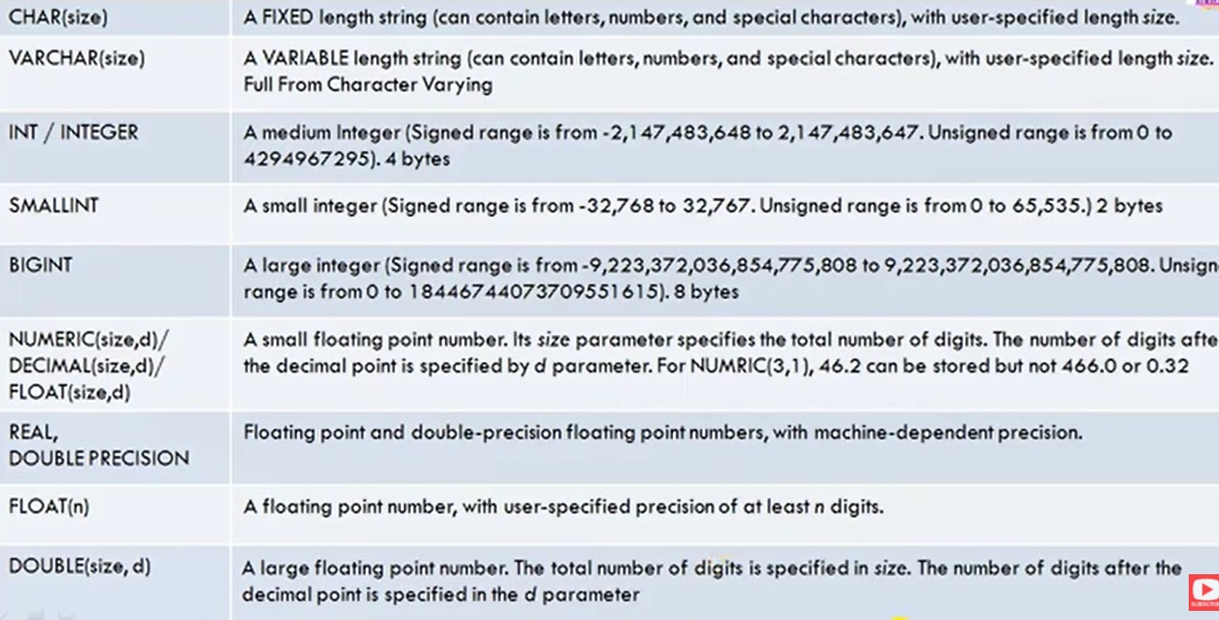
SQL Data Types

Slide 12
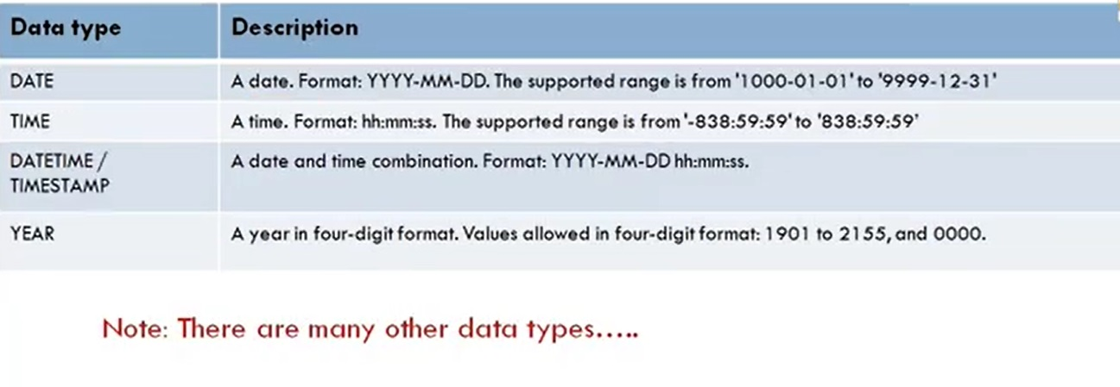
SQL Data Types

Slide 13
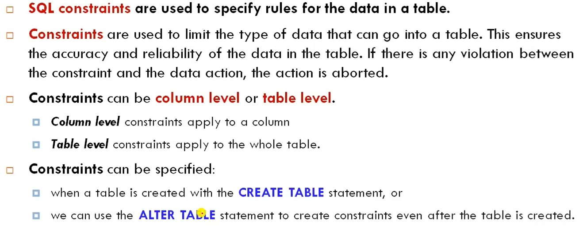
SQL Constraints

Slide 14
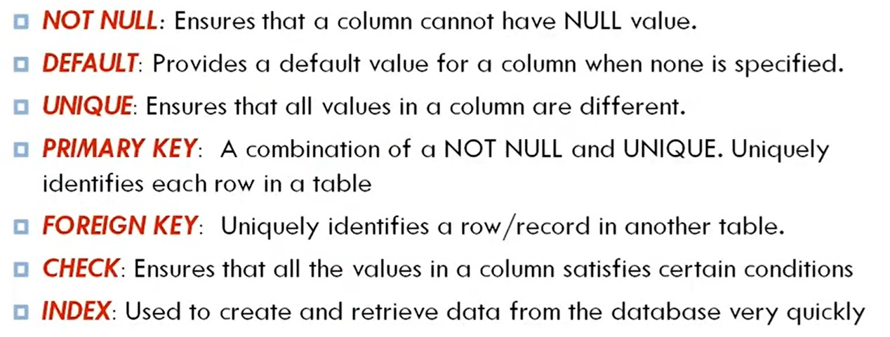
SQL Constraints cont..

Slide 15
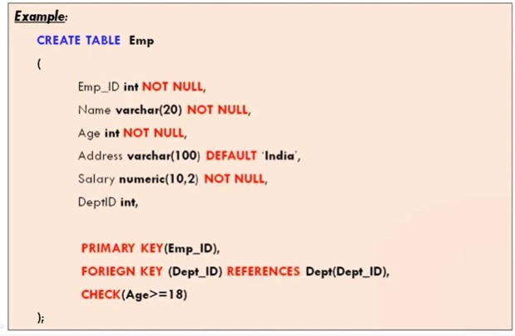
SQL Constraints cont..(Example)

Slide 16
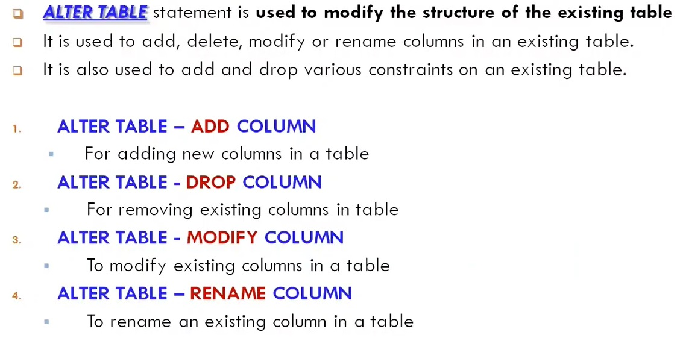
ALTER Command

Slide 17
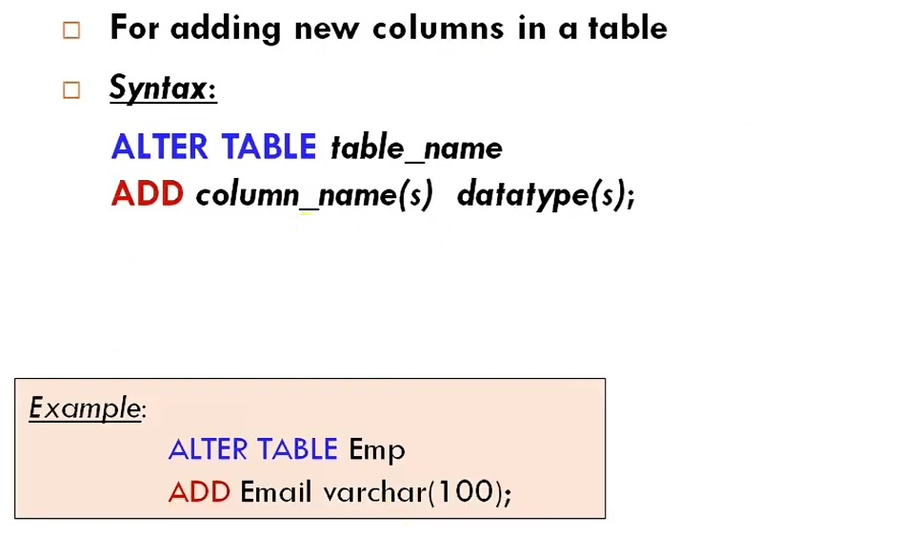
ALTER Table – Add Column

Slide 18
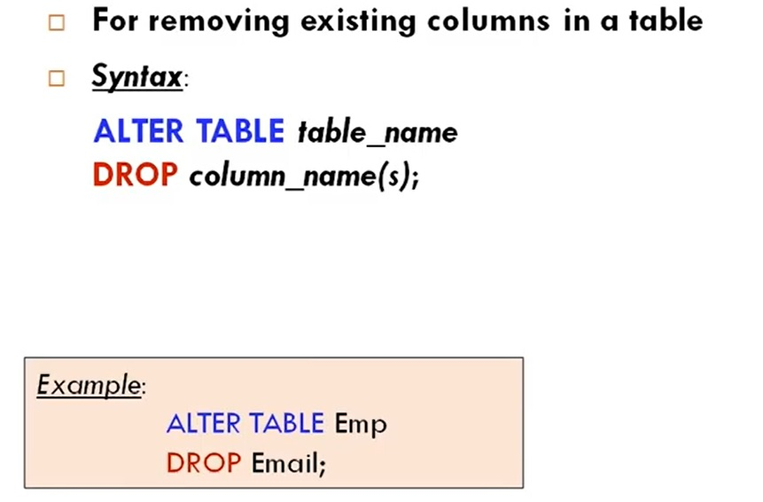
ALTER Table – Drop Column

Slide 19
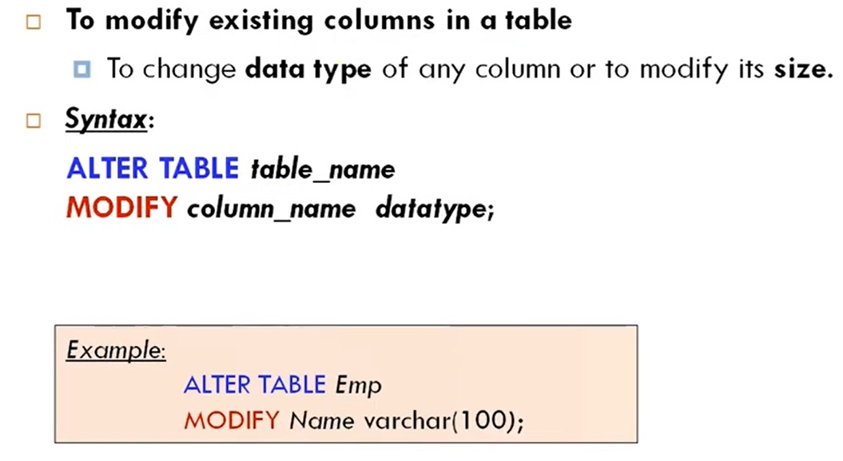
ALTER Table – Modify Column

Slide 20
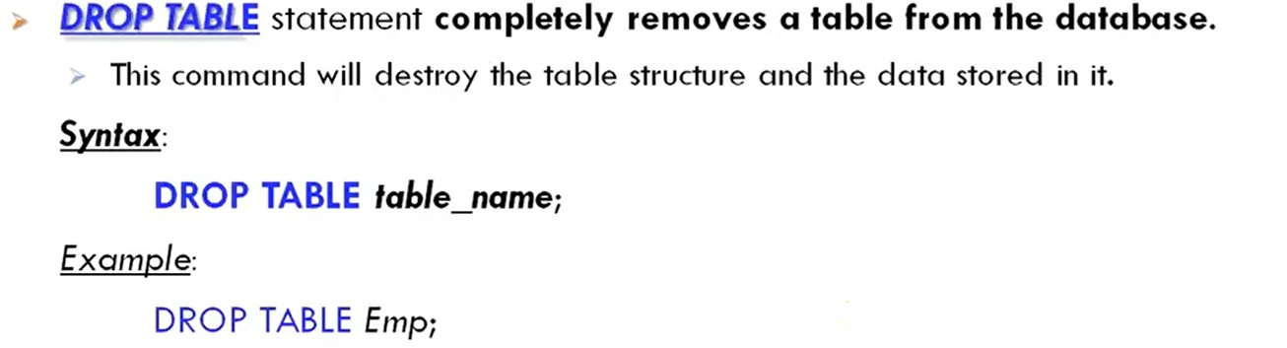
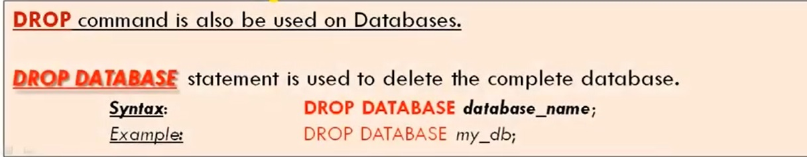
DROP Command

Slide 21
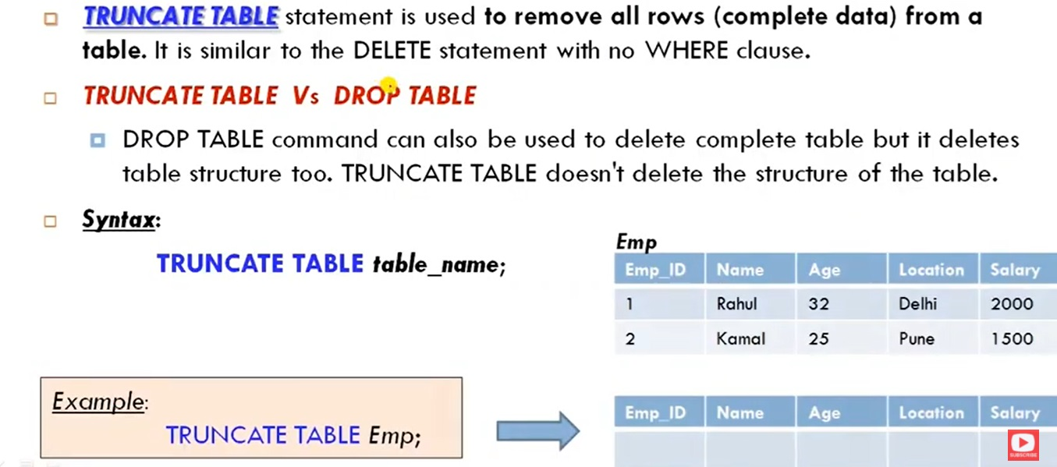
TRUNCATE Command

Slide 22
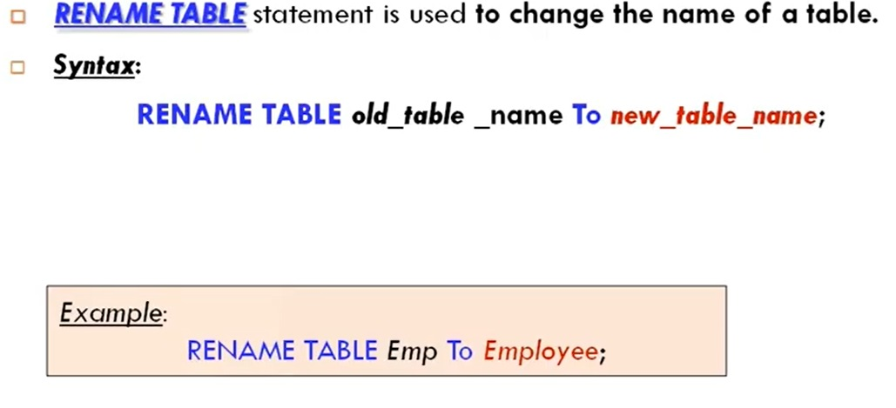
RENAME Command

Slide 23
Creating Tables
Write a SQL statement to create a table named customers with the following columns: customer_id (INT, primary key), first_name (VARCHAR(50)), last_name (VARCHAR(50)), email (VARCHAR(100)), and created_at (DATETIME).
CREATE TABLE customers (
customer_id INT PRIMARY KEY,
first_name VARCHAR(50),
last_name VARCHAR(50),
email VARCHAR(100),
created_at DATETIME DEFAULT CURRENT_TIMESTAMP
);

Slide 24
Modifying Tables
Write a SQL command to add a new column status (VARCHAR(20)) to the previous table.
ALTER TABLE orders
ADD COLUMN status VARCHAR(20);

Slide 25
Dropping Tables
Write a SQL command to drop the table products if it exists.
DROP TABLE IF EXISTS products;

Slide 26
Altering Table Constraints
You have a table called customers with a column email. Write a command to add a UNIQUE constraint on the email column to ensure that no two employees can have the same email address.
ALTER TABLE customers
ADD CONSTRAINT unique_email UNIQUE (email);

Slide 27
Creating Composite Primary Key
Create a table named course_enrollments with columns student_id, course_id, and enrollment_date. Define a composite primary key on student_id and course_id.
CREATE TABLE course_enrollments (
student_id INT,
course_id INT,
enrollment_date DATE,
PRIMARY KEY (student_id, course_id)
);

Slide 28
Changing Data Types
Write a SQL command to change the data type of the phone_number column in the contacts table from VARCHAR(15) to VARCHAR(20).
ALTER TABLE contacts
MODIFY COLUMN phone_number VARCHAR(20);

Slide 29
Renaming a Table
Write a command to rename the table inventory to stock.
ALTER TABLE inventory
RENAME TO stock;

Slide 30
Dropping Columns
If you have a table employees and want to remove the middle_name column, write the SQL command to do this.
ALTER TABLE employees
DROP COLUMN middle_name;

Slide 31
Creating a Foreign Key Constraint
You have two tables: students (with columns student_id, name) and courses (with columns course_id, course_name). Write a SQL command to create a student_courses table with a foreign key referencing student_id in the students table.
CREATE TABLE student_courses (
course_id INT,
student_id INT,
PRIMARY KEY (course_id, student_id),
FOREIGN KEY (student_id) REFERENCES students(student_id)
);

Slide 32
Creating a Table with Default Values
Write a SQL statement to create a table named products with a column stock_quantity that defaults to 0 if no value is provided.
CREATE TABLE products (
product_id INT PRIMARY KEY,
product_name VARCHAR(255),
stock_quantity INT DEFAULT 0
);

Slide 33
Using Check Constraints
Write a SQL statement to create a payments table with a payment_amount column that must be greater than zero (use a CHECK constraint).
CREATE TABLE payments (
payment_id INT PRIMARY KEY,
payment_date DATE,
payment_amount DECIMAL(10, 2) CHECK (payment_amount > 0)
);

Slide 34
Creating a Table with a Composite Unique Constraint
Create a users table with columns username, email, and created_at, and ensure that both username and email together must be unique.
CREATE TABLE users (
user_id INT PRIMARY KEY,
username VARCHAR(255),
email VARCHAR(255),
created_at TIMESTAMP DEFAULT CURRENT_TIMESTAMP,
UNIQUE (username, email)
);

Slide 35
Thank You

